Slide 1


ECC309: Microwave Engineering Lab
Presentation on
Design, Simulation, and Analysis of Microstrip Patch Antenna Using HFSS Software
Presented by
Dr. Nibash Kumar Sahu
Institute Post Doctoral Fellow (IPDF)
Electronics Engineering, IIT (ISM), Dhanbad

Slide 2
Outline
Introduction to Antenna
Antenna Classification
Types of Antenna
Microstrip Patch Antenna (MPA)
Geometry of Patches
How Rectangular MPA Radiates
Feeding Techniques
Advantages and Disadvantages of MPA
Applications
Input Antenna Parameters
Output Antenna Parameters
Substrate
Antenna Design Guideline ( Rectangular patch )
Modelling of MPA Using HFSS Software

Slide 3
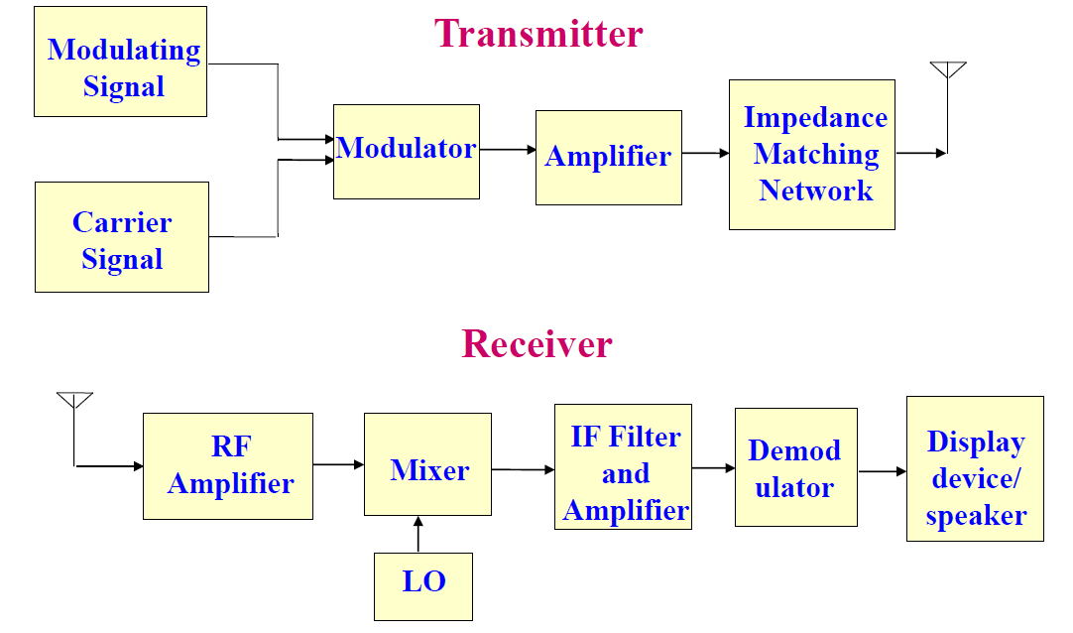
Introduction to Antenna
IEEE Standard Definition : the antenna or aerial as “a means for radiating or receiving radio waves.”
An antenna is basically a transforming device that will convert impedance of transmitter output (50/75 Ohm) into free space impedance (120pi or 377 Ohm).

Slide 4
ANTENNA CLASSSIFICATION
Frequency
Structure
Polarization
Radiation
VLF (3 -30 kHz)
LF (30-300 kHz)
MF (300-3000 kHz)
HF (3-30 MHz)
VHF (30-300 MHz)
Radio Freq. (300-3000 MHz)
Microwave (3-30 GHz)
Millimeter wave (30-300 GHz)
Wire Antenna
Aperture Antenna
Microstrip Patch antenna
Linear (Vertical/Horizontal)
Circular polarization
Elliptical Polarization
Isotropic
Omnidirectional
Directional

Slide 5
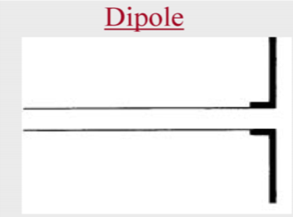
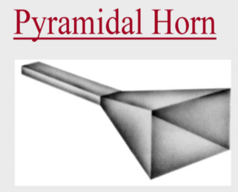
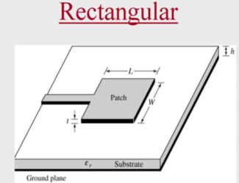
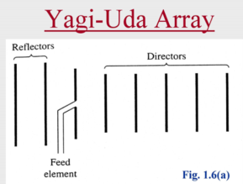
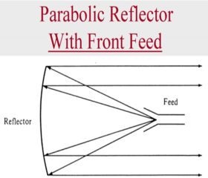
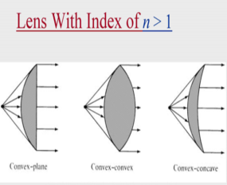
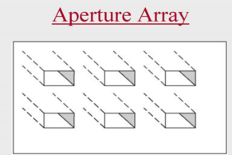
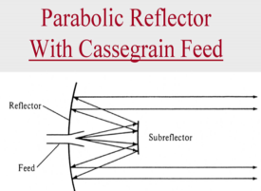
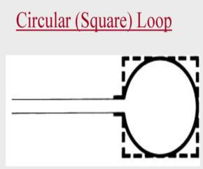
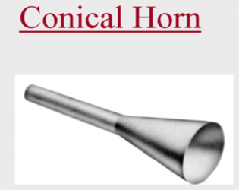
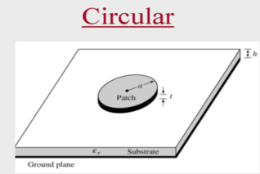
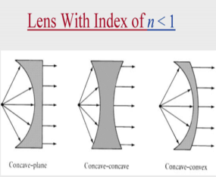
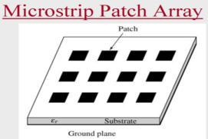
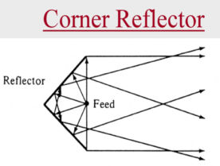
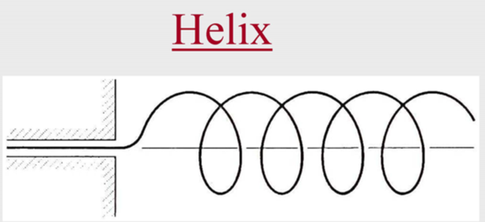
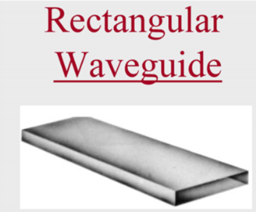
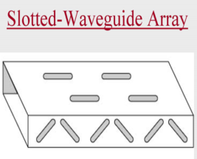
Types of Antennas
Wire antennas
Aperture antennas
Microstrip antennas
Array antennas
Reflector antennas
Lens antenna

Slide 6
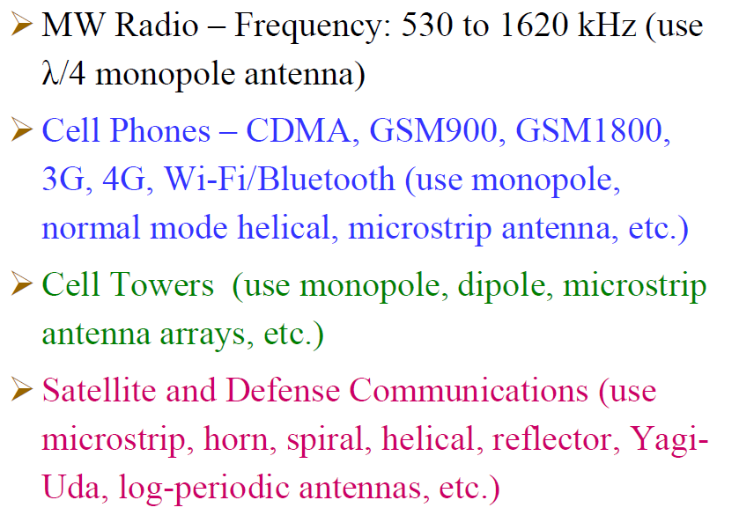
Antenna for Various Applications

Slide 7
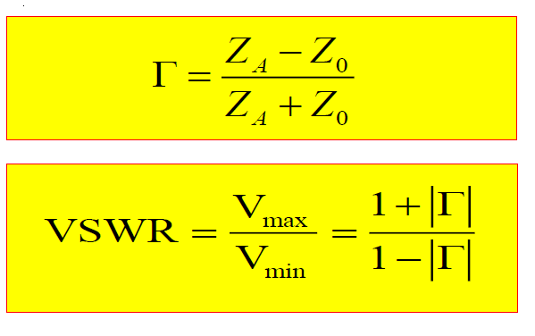
Antenna Parameter
Reflection Coefficients and VSWR: (Operating Bandwidth)
Source
Tx-Line
Antenna
Z₀
Z_{A}

Slide 8
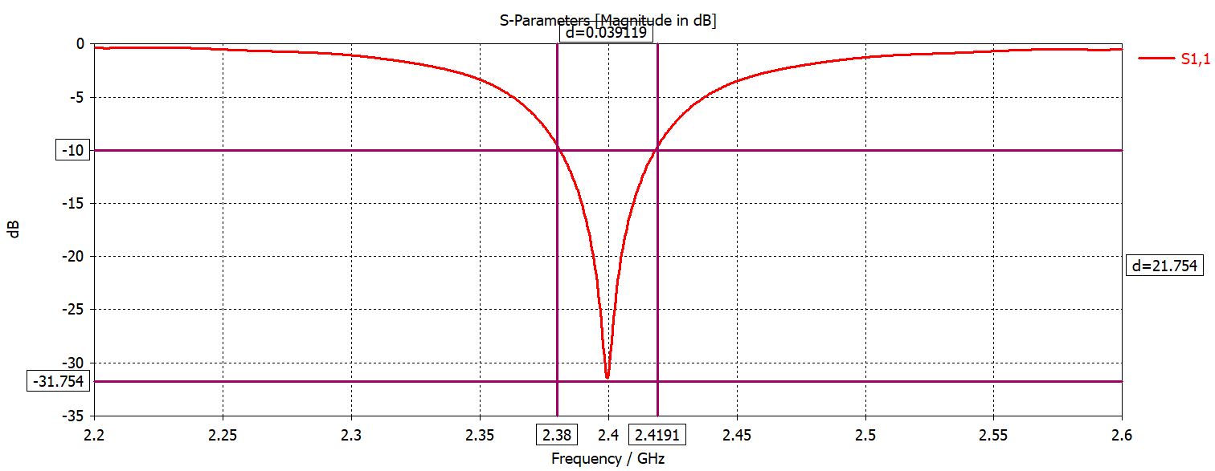
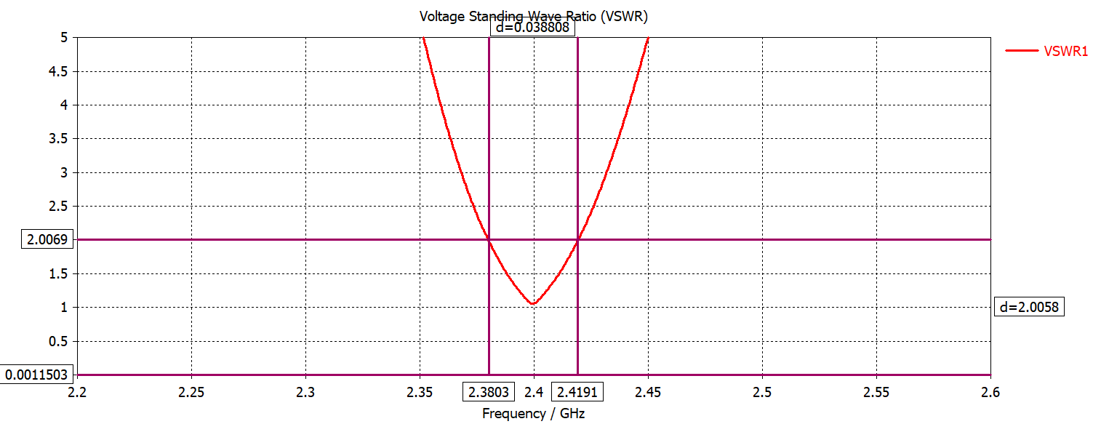
Antenna Parameter
S₁₁
Bandwidth
-10 dB frequency range (S11).
VSWR = 2 frequency range.
VSWR

Slide 9
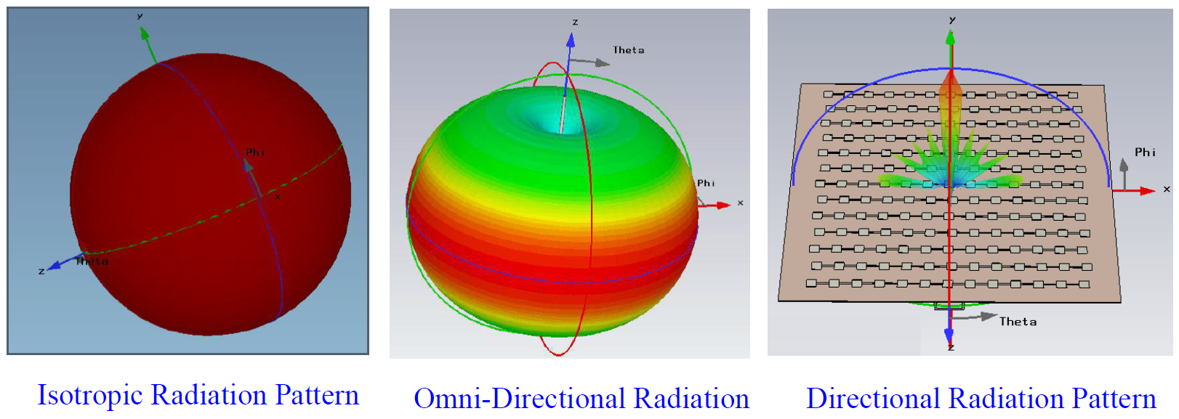
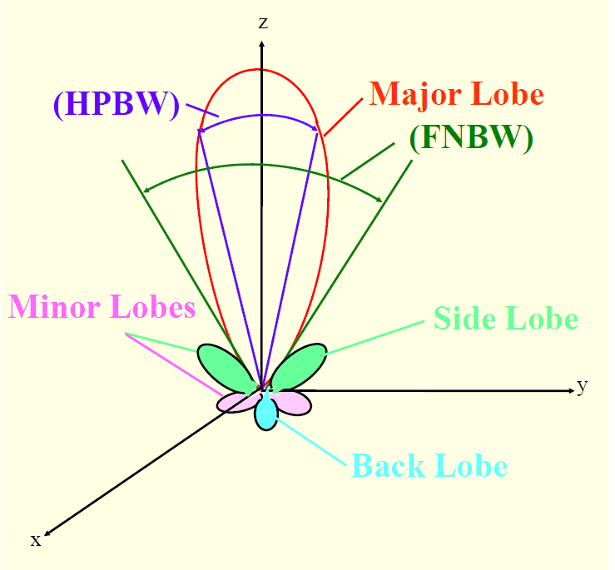
Antenna Parameter
Radiation Pattern:

Slide 10
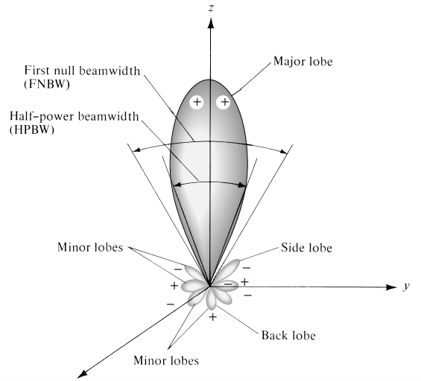
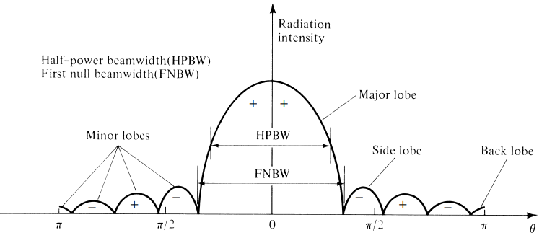
Output Antenna Parameters
A major lobe (also called main beam) is defined as “the radiation lobe containing the direction of maximum radiation.”
In some antennas, such as split-beam antennas, there may exist more than one major lobe.
A minor lobe is any lobe except a major lobe.
A side lobe is “a radiation lobe in any direction other than the intended lobe.” (Usually, a side lobe is adjacent to the main lobe and occupies the hemisphere in the direction of the main beam.)
A back lobe is “a radiation lobe whose axis makes an angle of approximately 180◦ with respect to the beam of an antenna.”
Minor lobes usually represent radiation in undesired directions, and they should be minimized.

Slide 11
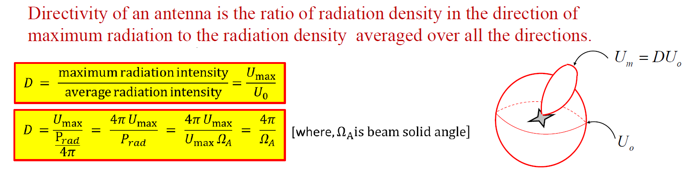
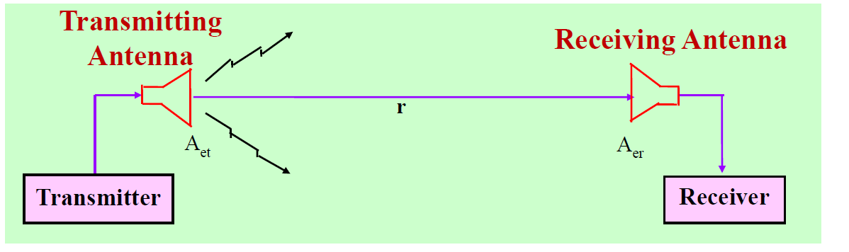

Antenna Parameter
Directivity, Gain and Efficiency:

Slide 12
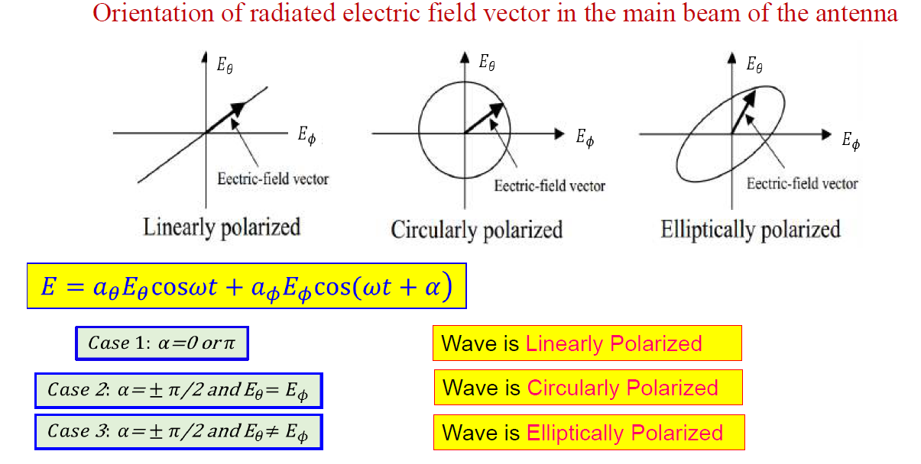
Polarization:

Slide 13
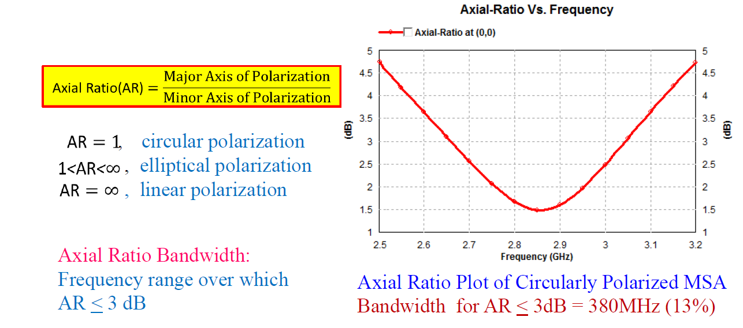
Axial Ratio:

Slide 14
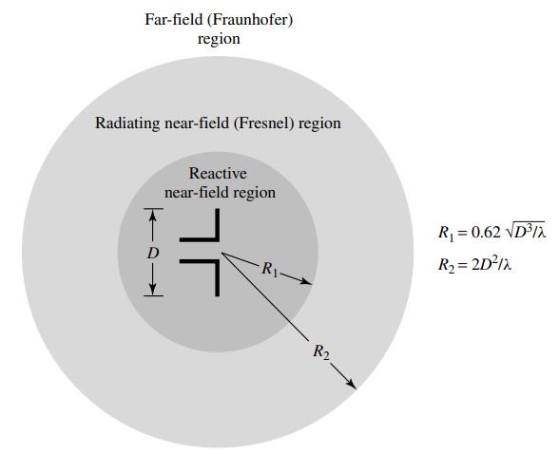
Field Regions
The space surrounding an antenna is usually sub divided into three regions:
(a) Reactive near-ﬁeld
(b) Radiating near-ﬁeld (Fresnel)
(c) Far-ﬁeld (Fraunhofer)

Slide 15
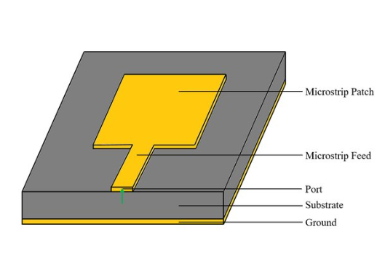
Microstrip Patch Antenna

Slide 16
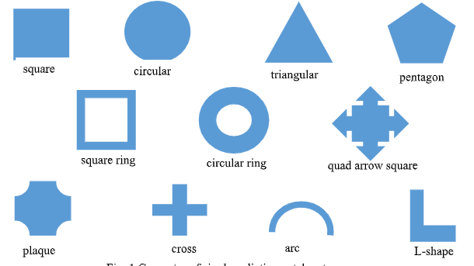
Geometry of Patches

Slide 17
Advantages / Disadvantages Of Microstrip Patch Antenna
Advantages
Disadvantages
Light weight and low volume.
Low profile configuration.
Easy to fabricate .
Can be easily integrated with microwave integrated circuits
Supports both linear as well as circular polarization.
Capable of dual and triple frequency operations.
Mechanically robust when mounted on rigid surfaces.
Narrow Bandwidth
Low efficiency
Low gain
Unwanted radiations from feeds and junctions.
Low power handling capacity
Surface wave excitation.
Poor end fire radiator

Slide 18
Applications
Satellite communications.
Microwave communications.
Cell phone antennas.
GPS antennas.
Integrated phased array system.
Remote sensing.
Non satellite based applications: such as medical hyperthermia.

Slide 19
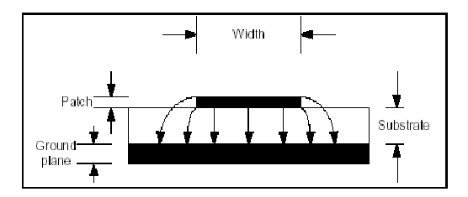
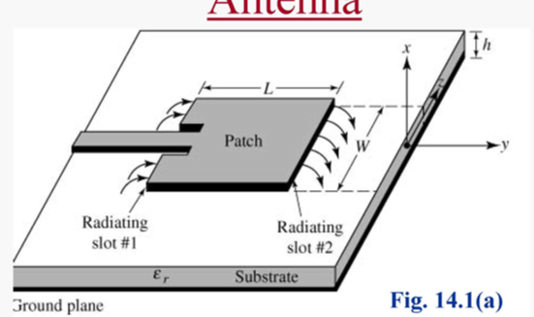
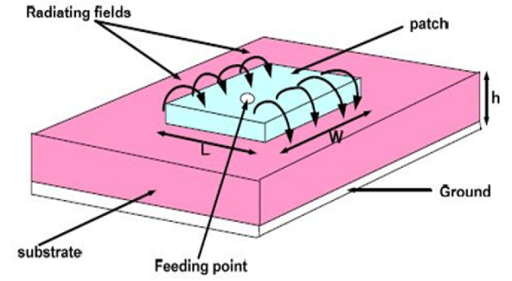
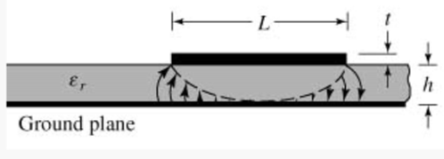
How Rectangular Microstrip Patch Antenna Radiates
In cavity, after excitation strong field is set up inside the cavity.
The fringing fields around the antenna is responsible for radiation.
Also known as voltage radiator.
The rectangular patch acts approximately as a resonant cavity (with short-circuit walls on top and bottom, open-circuit (PMC) walls on the edges).
To increase fringing effect or radiation:
(a) Low “ε_{r}”
(b) “h” should be high
(c) “W” should be high
What is feeding ?
The feed line connects the antenna to the receiver, transmitter, or transceiver. The line transfers radio-frequency (RF) energy from a transmitter to an antenna, and/or from an antenna to a receiver.

Slide 20
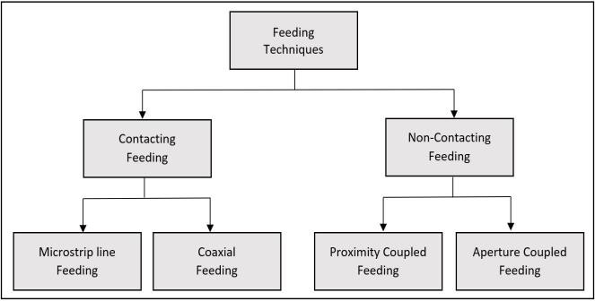
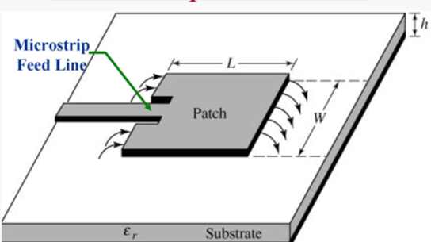
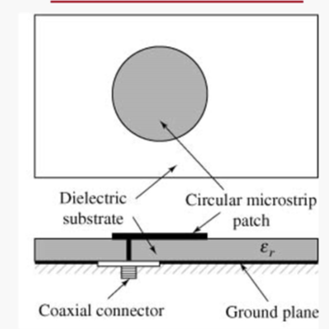
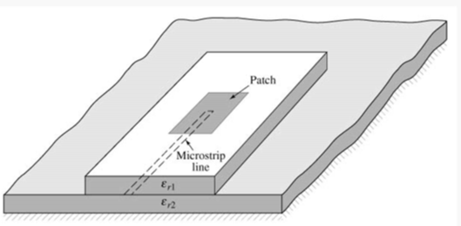
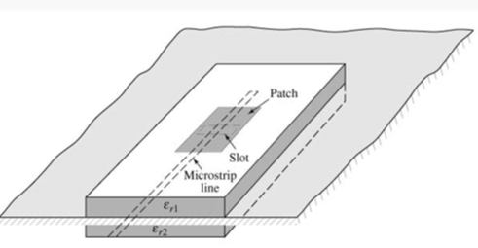
Feeding Techniques

Slide 21
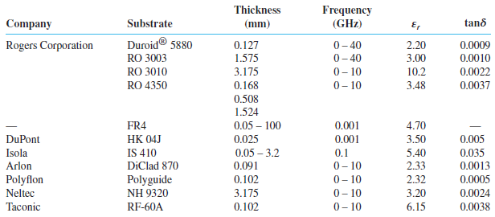
Typical substrates and their parameters

Slide 22
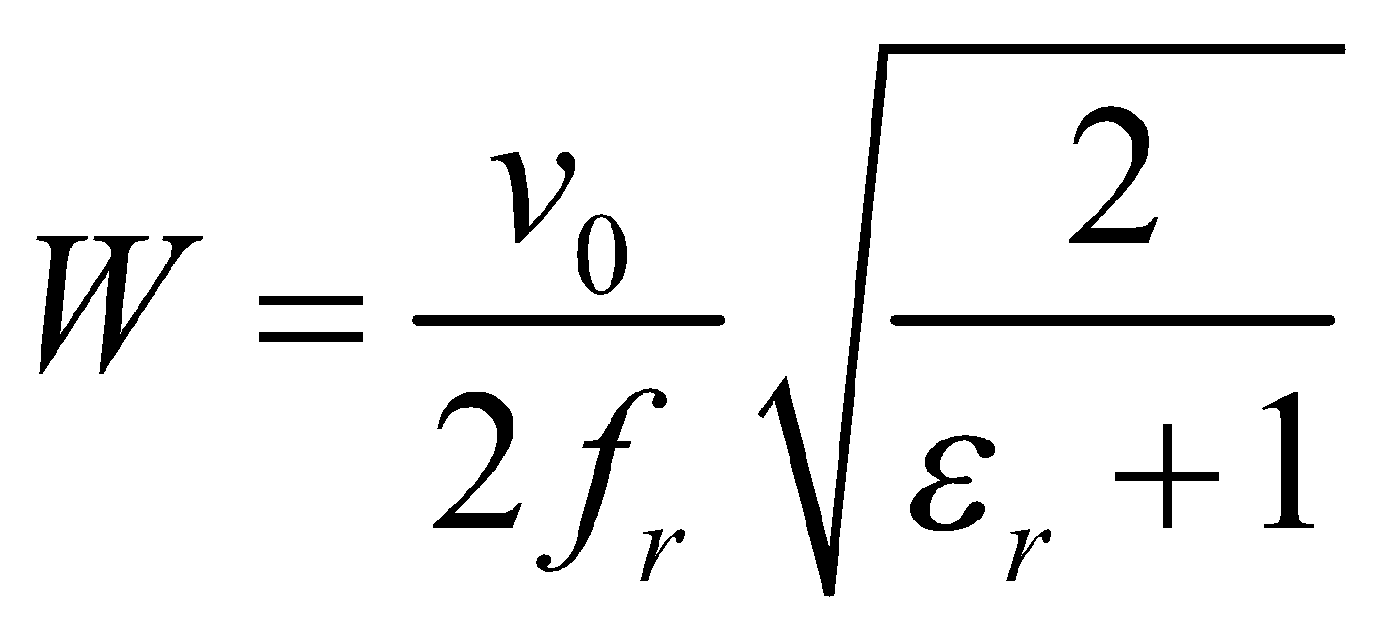
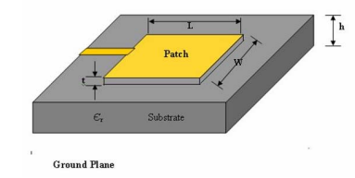
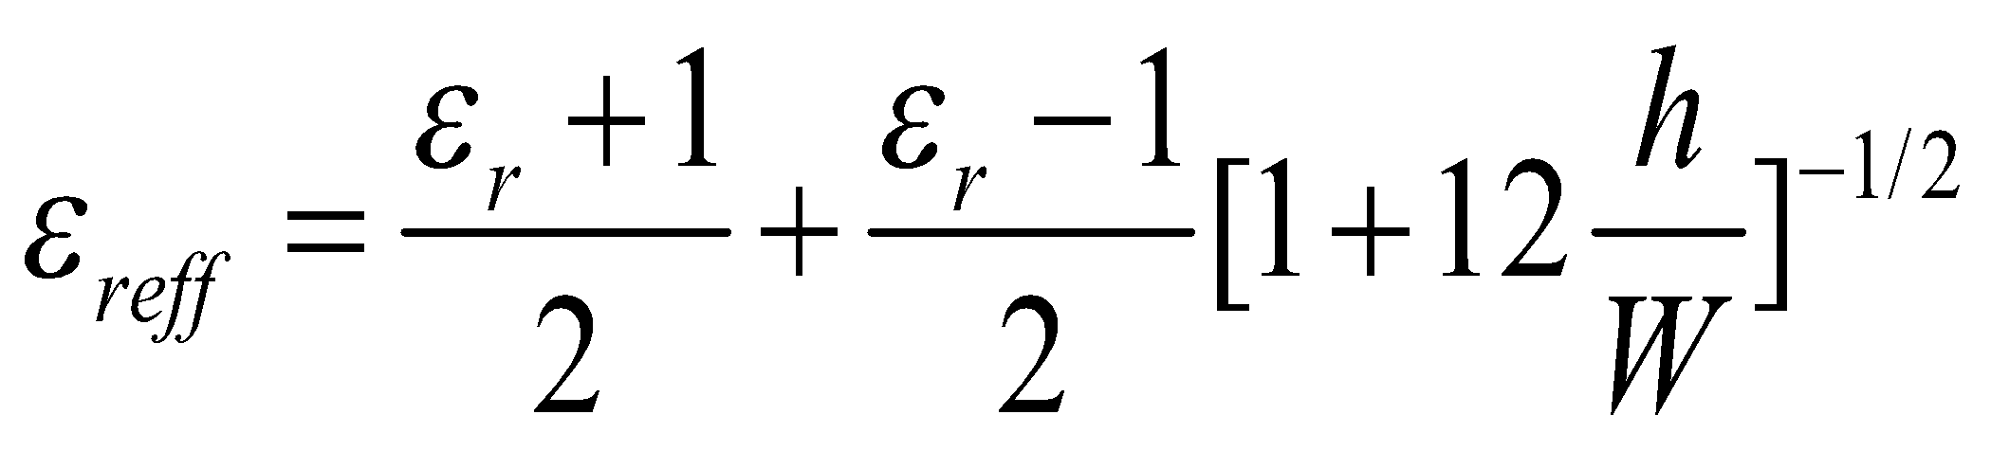
Antenna Design Guideline ( Rectangular Patch)
Based on Transmission -line model formulation
The procedure assumes that the specified information includes the dielectric constant of the substrate ( Er), the resonant frequency (fr), and the height of the substrate. The procedure is as follows:
Specify: εr, fr (in Hz), and h.
Determine: W and L
Design Procedure: For an efficient radiator, a practical width that leads to good radiation efficiencies is
Determine the effective dielectric constant of the microstrip antenna using

Slide 23
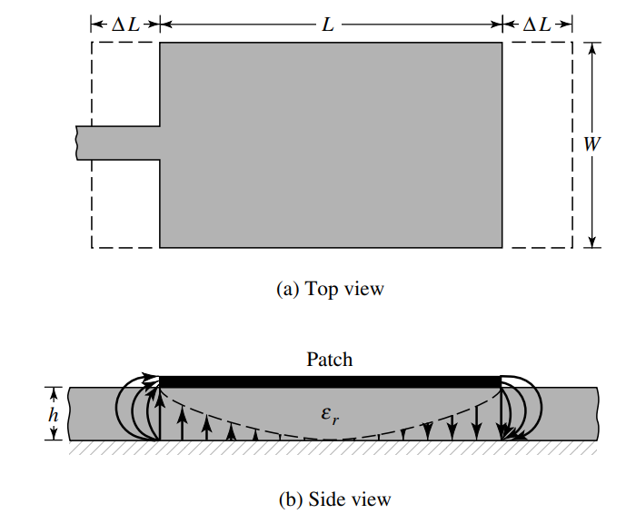
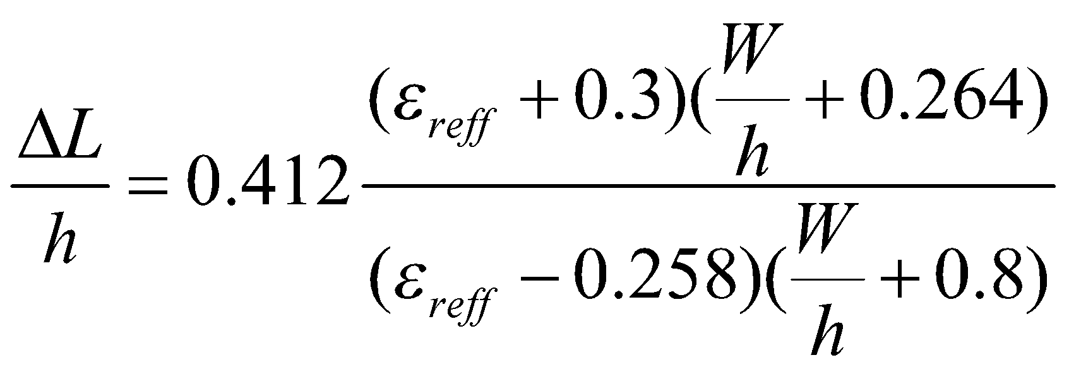
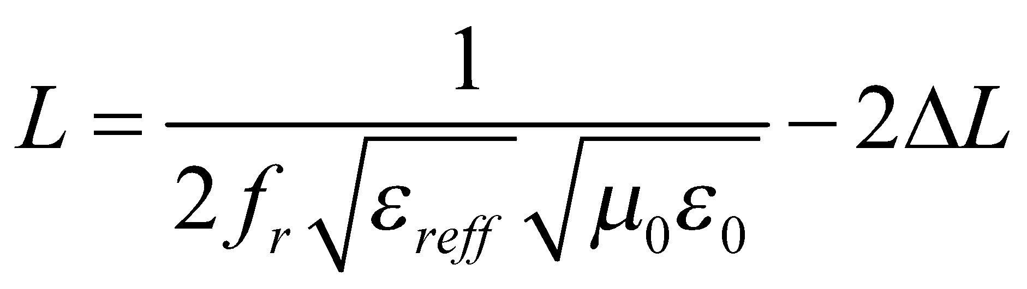
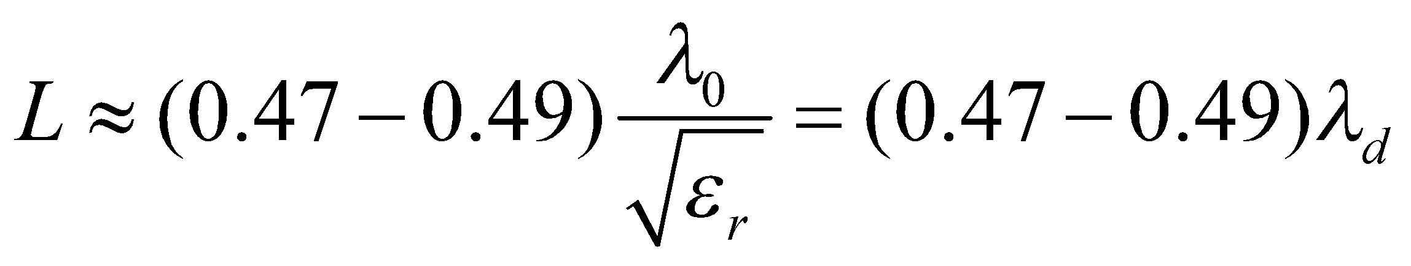
Antenna Design Guideline ( Rectangular Patch)
Once W is found, determine the extension of the length using
The actual length of the patch can now be determined for L
Typical lengths of microstrip patches vary between
The smaller the dielectric constant of the substrate, the larger is the fringing. Thus, the length of the microstrip patch is smaller.
In contrast, the larger the dielectric constant, the more tightly the field are held within the substrate. Thus the fringing is smaller and the length is longer and closer to half wavelength in the dielectric.

Slide 24






Example: Design a rectangular microstrip patch antenna using a substrate (Rogers 5880) with a dielectric constant of 2.2, h=1.6 mm, and copper thickness =0.035 mm for Wi-Fi application (2.4 to 2.483 GHz).
= 49 mm
= 2.12
= 42 mm
= 1.09 mm
= 39.5 mm

Slide 25




Feed Line:
Feed line length = 𝜆_{g}/4=20.5 mm
Feed line width = 1 mm for Zin = 50 Ω, ZA
= 236 Ω and Z0 = 111 Ω.

Slide 26


Introduction of HFSS
Logo
High Frequency Structure Simulator (HFSS) is a 3D electromagnetic (EM) simulation tool used to design a broad range of high frequency products such as antennas, filters, and IC packages. HFSS has advanced 3D electromagnetic field solvers based on finite elements and other integral equation methods supported by high performance computing technology that enable engineers to perform rapid and accurate design of high-frequency and high-speed electronic components.

Slide 27

Modelling of Rectangular Microstrip Patch Antenna in HFSS software
Step-1: Start and Insert the design project

Slide 28


Step-2: Design of Ground: Draw the rectangular box

Slide 29


Slide 30


Slide 31



Slide 32

Step-3: Design of Substrate: Draw the rectangular box

Slide 33



Slide 34

Step-4: Design of Patch: Draw the rectangular box

Slide 35

Step-5: Design of Feed Line: Draw the rectangular box

Slide 36

Step-6: Unite Patch and Feed

Slide 37


Step-6: 50 Ω-line

Slide 38

Step-7: Port design
YZ

Slide 39



Slide 40


Step-8: Solution Setup

Slide 41

Step-9: Excitation

Slide 42


Slide 43



Slide 44



Slide 45


Step-10: Solution Setup

Slide 46


Slide 47

Step-11: Radiation Boundary Creation

Slide 48


Slide 49


Step-12: Validation Check

Slide 50


Step-13: Simulate

Slide 51


Slide 52


Reflection Coefficient

Slide 53

VSWR Vs Frequency

Slide 54


Far-field Setup

Slide 55


3D Radiation Pattern (Gain Pattern)

Slide 56

2D Radiation Pattern (Gain Pattern)

Slide 57



Slide 58


Slide 59

Gain Vs Frequency

Slide 60



Slide 61


Axial Ratio

Slide 62



Example2: Design a rectangular microstrip patch antenna using a substrate (Rogers 5880) with a dielectric constant of 2.2, h=1.6 mm, and copper thickness =0.017 mm, which resonates at 5.9 GHz.
Mean frequency of the range ( f ): 5.9 GHz
Port impedance (Zo): 50 Ω
Dielectric constant of the substrate (ε_{r}): 2.2
Substrate height (h): 1.6 mm
Wavelength (λ): 50.8 mm
Patch size (W): 19.4 mm
Patch size (L): 15.6 mm
Minimum ground plane size (L_{g}): 34 mm
Minimum ground plane size (W_{g}): 38 mm
Distance (X₀ ) to match input impedance 50 Ω: 6 mm
Gap width (g): 0.63 mm
Microstrip 'feeder' width (W_{t}): 5 mm
Input antenna parameters
Reflection coefficient
VSWR
Output antenna parameters
Radiation pattern
(a) 2D Plot
(b) 3D plot
Gain
Axial Ratio
$$R_{in}(X=0)≅90\frac{{ε_{r}}^{2}}{ε_{r}−1}{\left(\frac{L}{W}\right)}^{2}$$
$$R_{in}({X=X}_{o})=R_{in}(X=0)\cos^{2}\left(\frac{π}{L}X_{o}\right)$$

Slide 63
Antenna parameters to study
S-parameters (reflection coefficient)
Voltage Standing Wave Ratio (VSWR)
Gain of an antenna
Axial Ratio
Radiation Pattern
(A) 2D Radiation Pattern
(B ) 3D polar plot

Slide 64
Thank You

